Slide 1


Department of Computer Science &Engineering Artificial Intelligence & Machine Learning A.P. Shah Institute of Technology G.B.Road , Kasarvadavli , Thane(W), Mumbai-400615 UNIVERSITY OF MUMBAI Academic Year 2024-2025

Slide 2

AIR POLLUTION DETECTION USING ML
Bhushan Kokate (22106070) Prathamesh Kulkarni (22106032) Shreyas Joshi (22106006) Siddhesh Kaware (22106053)
Project Guide
Prof.Yogeshwari Hardas
Notes:
2

Slide 3
Outline
Introduction
Literature Survey of the Existing Systems
Limitations of the Existing Systems
Problem Statement
Proposed System Design
Framework/Algorithm
Technologies Stack for Proposed System
Details of Database / Input to the System
Implementation(Partial)
Conclusion
References
Notes:
3

Slide 4
Introduction
Purpose: Monitors air quality to tackle pollution, reducing health risks like asthma and environmental harm.
Real-Time AQI: Computes AQI instantly from pollutants (PM2.5, PM10, O3) using OpenWeatherMap data.
Health Guidance: Delivers tailored health advice based on AQI levels and pollutant concentrations.
Smart Forecasts & Tech: Predicts 24-hour AQI with Scikit-learn’s ML, powered by Flask and a web UI.
Notes:
4

Slide 5
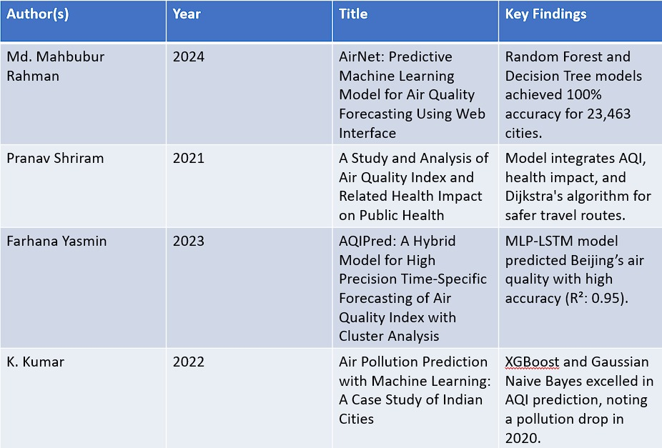
Literature Survey of the existing system
Notes:
5

Slide 6
Limitations of the Existing Systems
Limited Real-Time Data: Updates often delayed (hours/days), missing critical pollution peaks due to infrequent sensor readings.
Basic Predictions: Forecasts lack detail, usually just daily averages, without hourly trends or ML-based insights.
Incomplete Health Advice: Recommendations are broad, rarely addressing specific pollutant effects (e.g., PM2.5 vs. O3 risks).
Static Models: Rely on fixed formulas (e.g., EPA AQI), not adapting to local patterns via machine learning.
Poor Accessibility: Interfaces are often technical, lacking user-friendly web/mobile apps for real-time access.

Slide 7
Problem statement
Air pollution is escalating worldwide, harming public health with respiratory issues and environmental damage, but current systems struggle with infrequent updates, lack of detailed forecasts, and one-size-fits-all alerts, failing to deliver real-time, tailored solutions for users to act effectively.

Slide 8
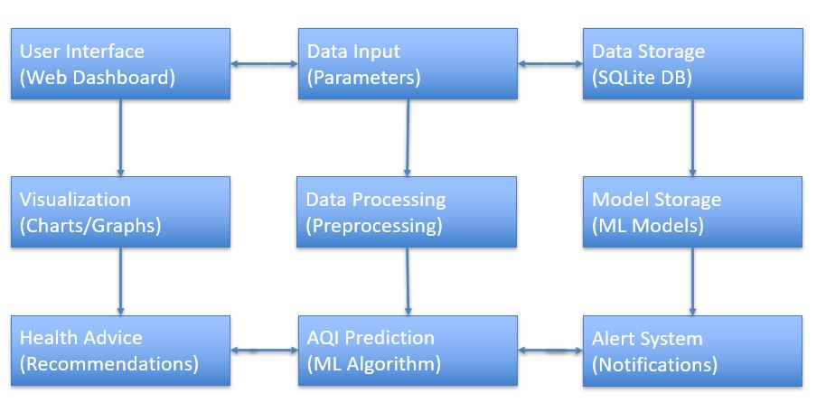
Proposed System Design
Notes:
8

Slide 9
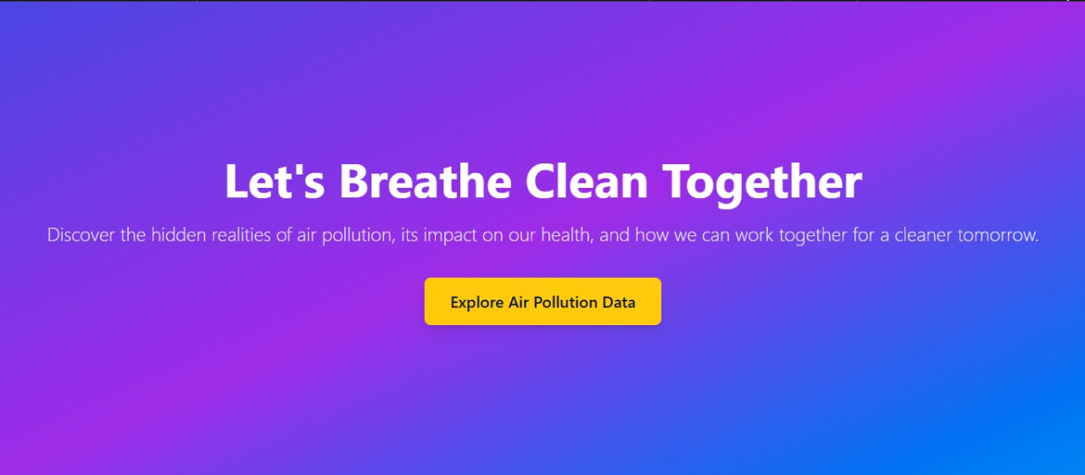
Implementation
Welcome Page
Notes:
9

Slide 10
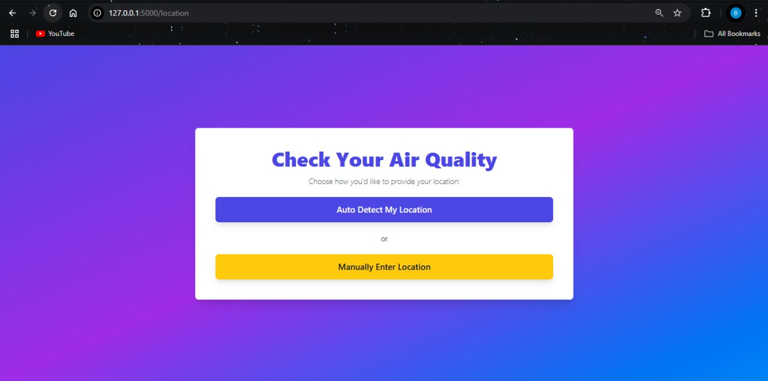
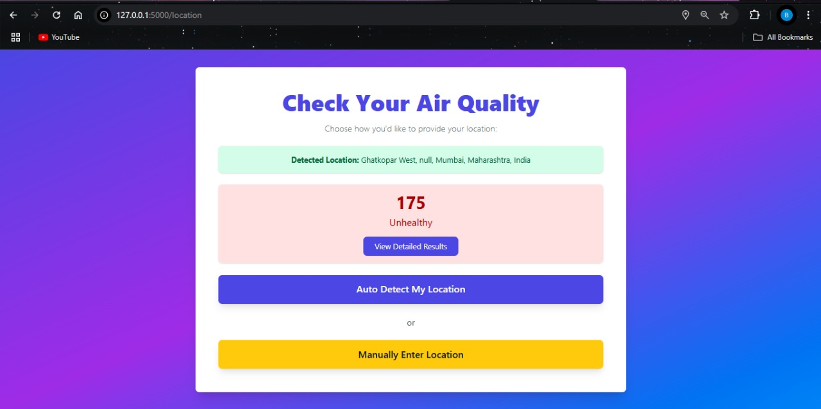
Implementation
Location Options
Tracked user’s current location & AQI

Slide 11

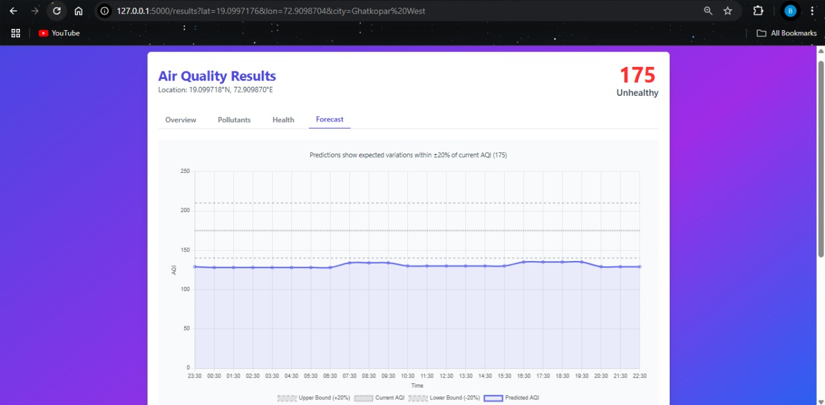
Implementation
Air Quality Checker – Manual Location Input
Air Quality Results – Unhealthy Level (175 AQI))

Slide 12
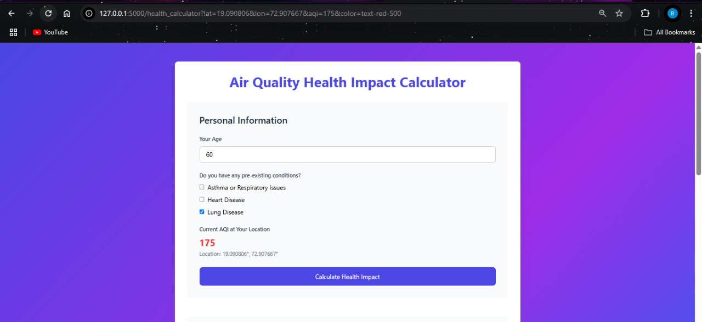
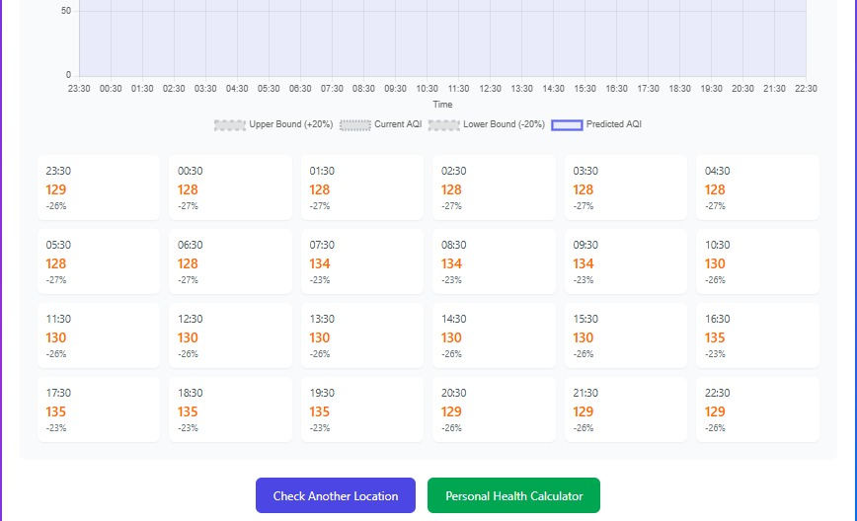
Implementation
Air Quality Health Impact Calculator
Air Quality Forecast – Hourly AQI Prediction

Slide 13
FRAMEWORKS
Frameworks :
Flask: Python web framework for building the app, handling routes (e.g., /results), and rendering UI with Jinja2 templates.
Scikit-learn: Machine learning library for Random Forest Regressor, data preprocessing (LabelEncoder, StandardScaler), and hyperparameter tuning (GridSearchCV).
Pandas: Data analysis tool for loading CSV datasets, cleaning data, and calculating historical stats (e.g., mean AQI).
NumPy: Numerical library for fast array operations, used in AQI calculations and feature preparation for ML models.
Jinja2: Templating framework integrated with Flask to dynamically generate HTML pages with AQI and forecast data.

Slide 14
ALGORITHMS
Algorithms :
AQI Calculation: Uses EPA piecewise linear interpolation to convert pollutant levels (PM2.5, PM10, etc.) into a 0-500 AQI score, taking the max value.
ML Prediction: Random Forest Regressor trained on historical data, tuned with GridSearchCV, blends with standard AQI (70% ML + 30% EPA) for precision.
24-Hour Forecast: Applies hourly pollutant variations (e.g., +2% PM in rush hours) to current data, caps at ±20% of base AQI, outputs hourly predictions.
Health Recommendations: Maps AQI to categories (e.g., 151-200: Unhealthy) and checks pollutant thresholds (e.g., PM2.5 > 55 μg/m³) for tailored advice.

Slide 15
Technology Stack for Proposed System
Backend
Python: Core programming language for logic, data processing, and machine learning.
Flask: Lightweight web framework for building the API and serving the web interface.
Pandas: Data manipulation and analysis for handling air quality datasets.
NumPy: Numerical computations for AQI calculations and predictions.
Scikit-learn: Machine learning library for Random Forest Regressor and data preprocessing
(LabelEncoder, StandardScaler).
Joblib: Model persistence for saving/loading trained ML models, encoders, and scalers
Frontend
HTML/CSS/JavaScript: Core web technologies for rendering templates and user interaction.
Jinja2: Templating engine integrated with Flask for dynamic HTML generation.
Google Maps API: Geolocation and map visualization for location-based features.
.
Notes:
15

Slide 16
Dataset description
Real-Time Data (Open Weather Map API): Source: Open Weather Map API (accessed via latitude/longitude inputs).
Content: Includes real-time measurements of PM2.5, PM10, NO₂, SO₂, CO, and O₃ in μg/m³ converted to a 0-500 AQI scale.
Coverage: Data from 23,463 cities worldwide, updated dynamically.
Usage: Used for current AQI calculations and web interface displays.
Training Dataset (air_quality_data.csv): Source: Local file in the data directory.
Content: Contains historical air quality data with columns for city, PM2.5, PM10, NO₂, SO₂, CO, O₃ (in appropriate units), and calculated AQI. Includes a city_encoded column for machine learning.
Coverage: Multi-city dataset (specific cities not detailed but implied to be diverse).
Usage: Used to train the Random Forest Regressor model with features scaled via StandardScaler.

Slide 17
Conclusion
The Air Pollution Predictor addresses these issues by offering real-time AQI calculations, precise 24-hour forecasts using machine learning, and personalized email alerts, equipping users with detailed health recommendations and a user-friendly web interface for proactive air quality management.
Notes:
17

Slide 18
References
Md. Mahbubur Rahman (2024) - AirNet: predictive machine learning model for air quality forecasting using web interface .
Pranav Shriram (2021) - A Study and Analysis of Air Quality Index and Related Health Impact on Public Health :
Farhana Yasmin (2023) - AQIPred: A Hybrid Model for High Precision Time Specifc Forecasting of Air Quality Index with Cluster Analysis
K . Kumar (2022) - Air pollution prediction with machine learning: a case study of Indian cities
https://doi.org/10.1186/s40068-024-00378-z
http://dx.doi.org/10.2139/ssrn.3768477
https://doi.org/10.1007/s44230-023-00039-x
https://doi.org/10.1007/s13762-022-04241-5
Notes:
18

Slide 19
Thank You...!!
Notes:
19

